Slide 1
Angular
Author: Giau Le

Slide 2
Agenda
Routing & Navigation (cont.)
Dependency injection
Promise, Async, Await
Http Client
RxJs - Observables (Optional)
Authentication Demo

Slide 3
References
Roadmap
https://roadmap.sh/frontend
Prerequisite
https://www.w3schools.com/css/
https://www.w3schools.com/html/
https://www.typescriptlang.org/docs/handbook/typescript-in-5-minutes.html
Angular Docs
https://angular.dev
SCSS
https://sass-lang.com/guide/
UI Libs
https://getbootstrap.com/ or https://tailwindcss.com/docs/guides/angular
https://material.angular.io/ -> angular components
RxJs
https://rxjs.dev/
Project demo
https://github.com/helenhash/angular-demo

Slide 4
Routing & Navigation
Some keywords
Router-outlet, RouterLink, ActiveRouterLink…
Nesting routes
Page title
Identify the active route (Ex: how to show active menu?)
RouterData: get data from Router
https://ultimatecourses.com/blog/dynamic-page-titles-angular-2-router-events

Slide 5
Dependency injection
Dependency injection (DI), is an important application design pattern. Angular has its own DI framework, which is typically used in the design of Angular applications to increase their efficiency and modularity.
Dependencies are services or objects that a class needs to perform its function.
DI is a coding pattern in which a class asks for dependencies from external sources rather than creating them itself.

Slide 6
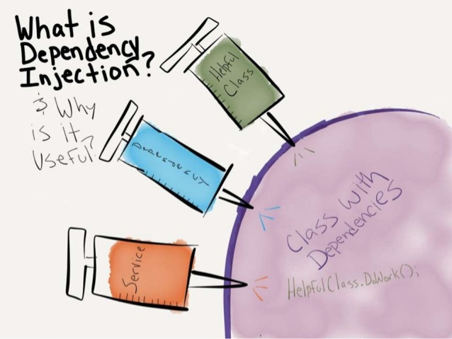
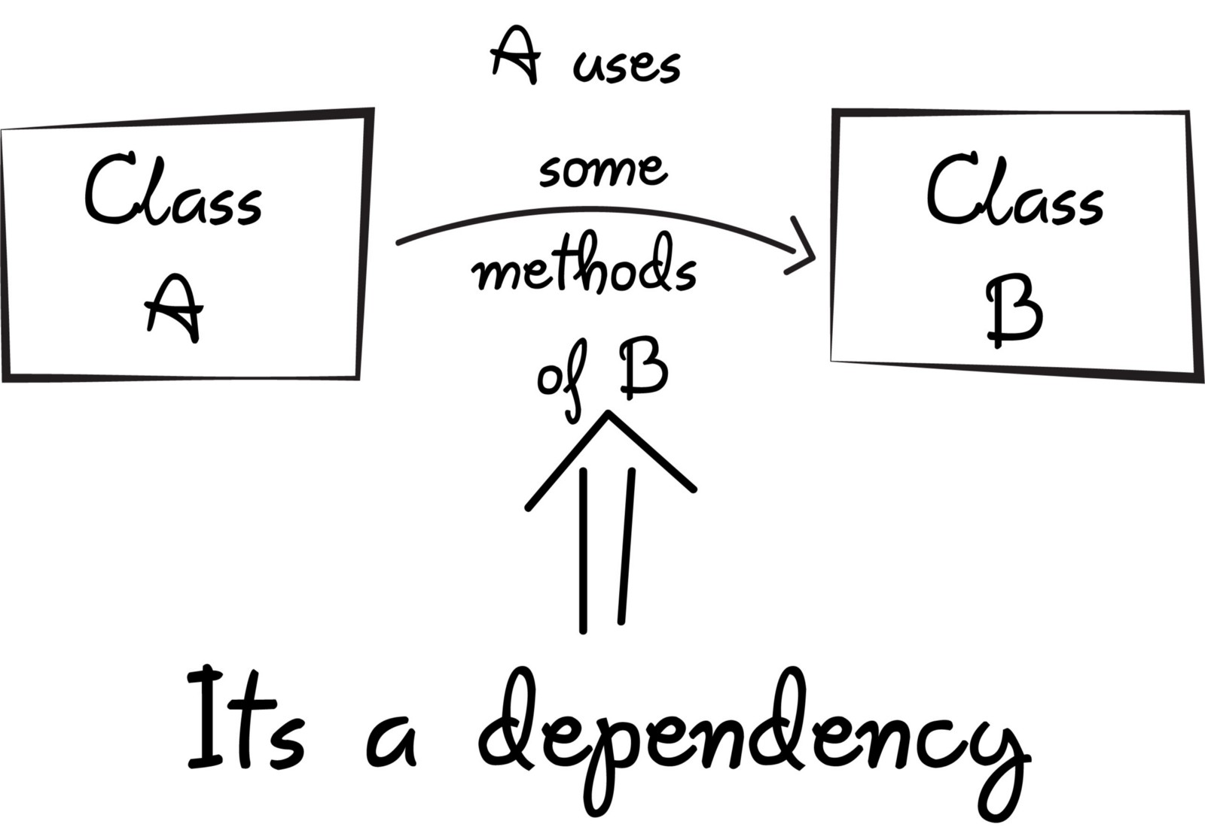
Dependency injection

Slide 7
Dependency injection
Create an injectable service class
ng generate service heroes/hero
Using decorator @Injectable
Configure an injector with a service provider
In the @Injectable() decorator for the service itself.
In the @NgModule() decorator for an NgModule.
In the @Component() decorator for a component.
Injecting services
Tell Angular to inject a dependency in a component's constructor by specifying a constructor parameter with the dependency type

Slide 8
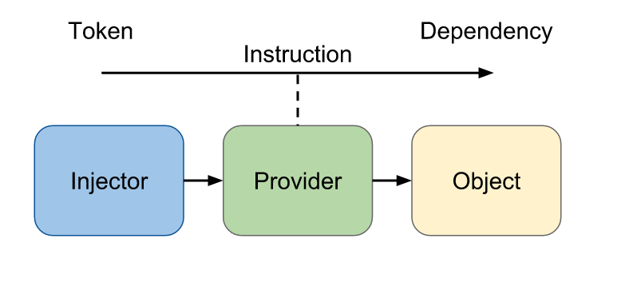
Dependency injection

Slide 9
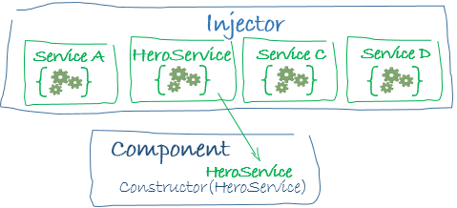
Dependency injection
Dependency providers
A dependency provider configures an injector with a DI token, which that injector uses to provide the concrete, runtime version of a dependency value.
The injector relies on the provider configuration to create instances of the dependencies that it injects into components, directives, pipes, and other services.

Slide 10
Dependency injection
https://angular.dev/guide/di/dependency-injection
Tree-shakable providers
providedIn: 'root',
-> Singleton
Injectable

Slide 11
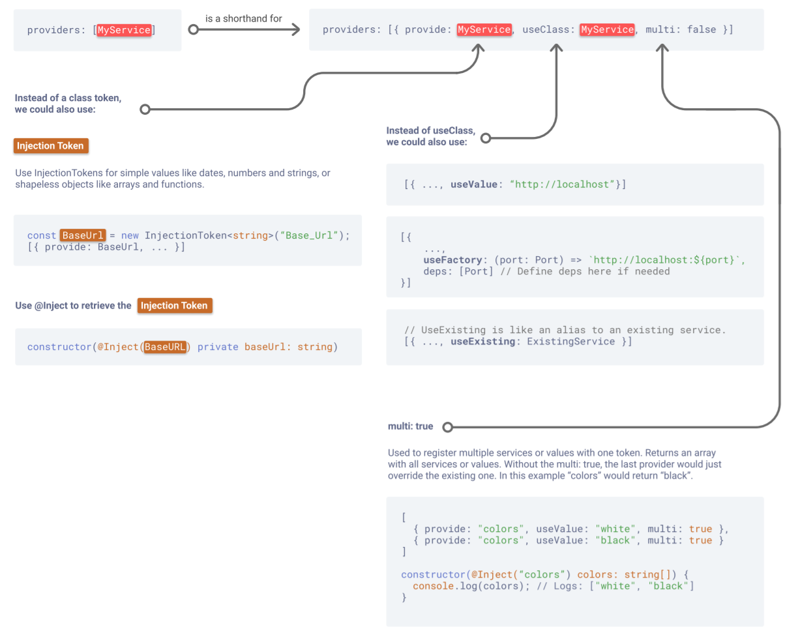
Dependency injection

Slide 12
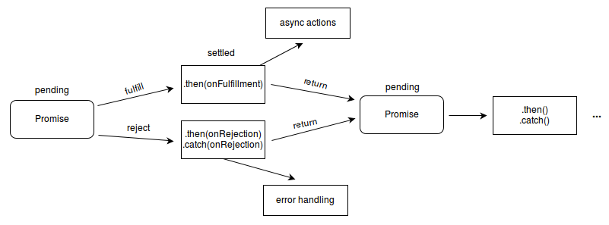
Promise
Lets asynchronous methods return values like synchronous methods: instead of immediately returning the final value, the asynchronous method returns a promise to supply the value at some point in the future.
https://www.w3schools.com/js/js_promise.asp

Slide 13
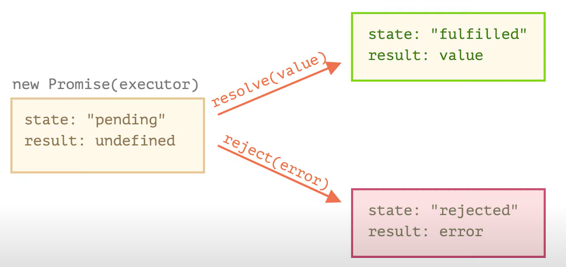

Slide 14
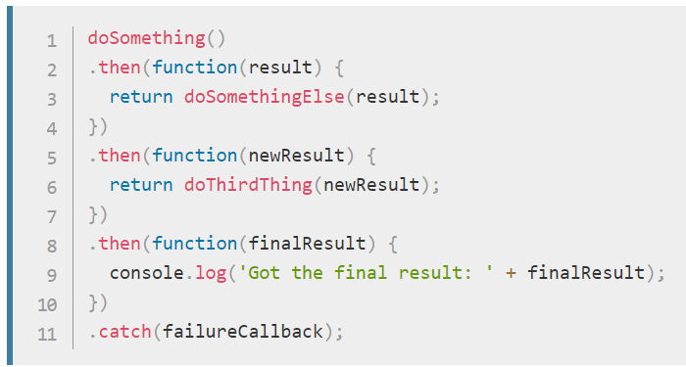
Promise
Ex
const promise = createAudioFileAsync(audioSettings); promise.then(successCallback, failureCallback)
Chaining

Slide 15
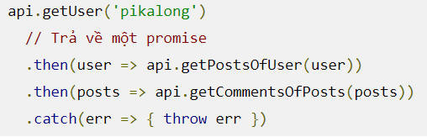
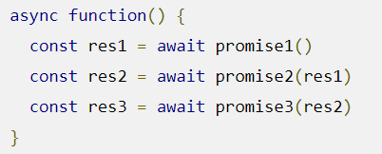
Promise (Javascript)

Slide 16
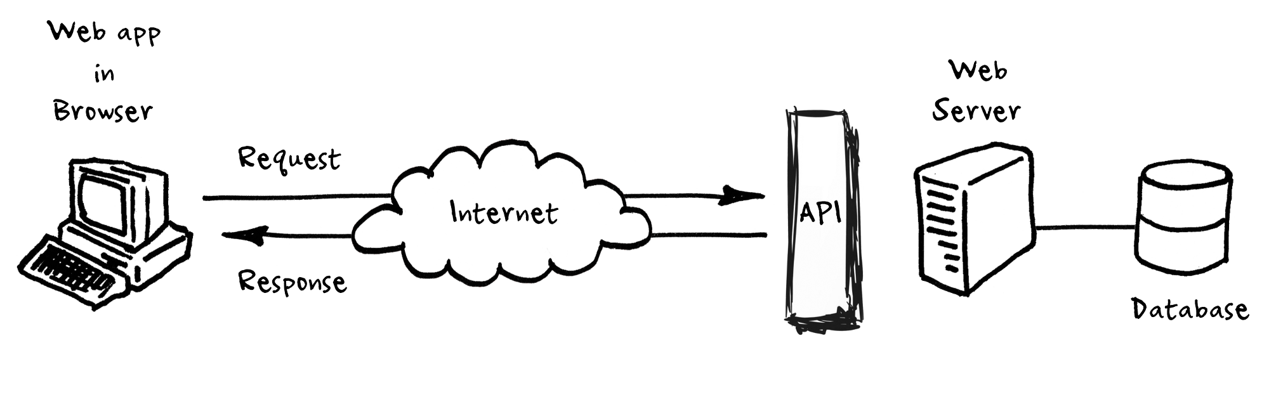
Http Client
https://angular.io/guide/http
Most front-end applications need to communicate with a server over the HTTP protocol, to download or upload data and access other back-end services.
HttpClient class in @angular/common/http.

Slide 17
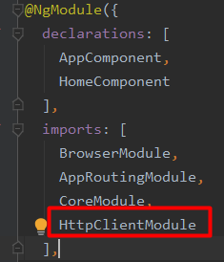
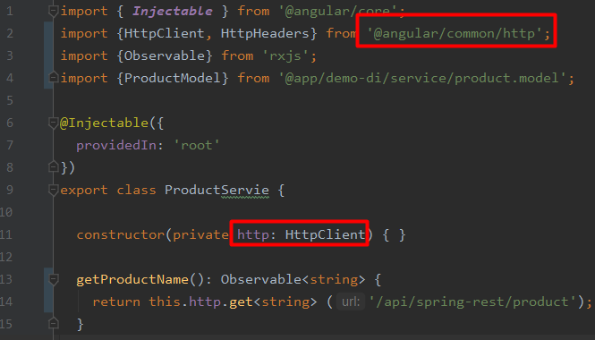
Http Client
Setup for server communication
Import the Angular HttpClientModule
Inject the HttpClient service as a dependency of an application class
Using RxJS observable and operator symbols

Slide 18
Http Client
Requesting data from a server
The aynchronous method sends an HTTP request, and returns an Observable that emits the requested data when the response is received
Example: get() method takes two arguments:
endpoint URL
options object

Slide 19
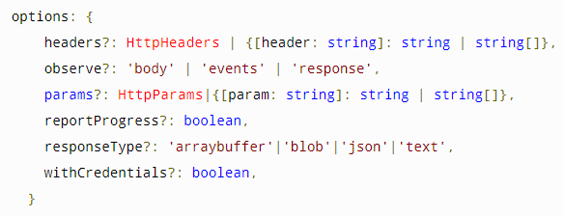
Http Client
The observe option specifies how much of the response to return.
The responseType option specifies the format in which to return data.

Slide 20
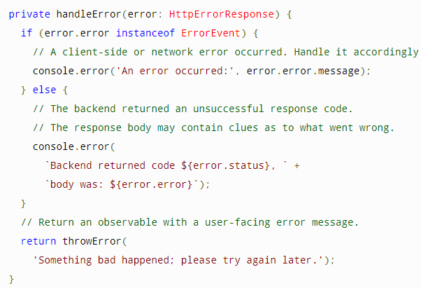
Http Client
Handling request errors
The handler returns an RxJS ErrorObservable with a user-friendly error message
Using a pipe to send all observables returned by the HttpClient.get() call to the error handler.
return this.http.get<Config>(this.configUrl) .pipe( catchError(this.handleError) );

Slide 21
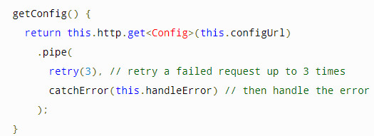
Http Client
Retrying a failed request
The RxJS library offers several retry operators.
For example, the retry() operator automatically re-subscribes to a failed Observable a specified number of times.

Slide 22
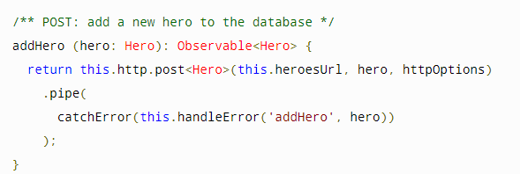
Http Client
Other methods
HttpClient supports other HTTP methods such as PUT, POST, and DELETE

Slide 23
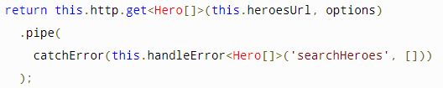
Http Client
Configuring HTTP URL parameters
Use the HttpParams class with the params request option to add URL query strings in your HttpRequest.
import {HttpParams} from "@angular/common/http";
const paramHeres = new HttpParams({fromString: 'name=foo'});
const options = { params: paramHere}

Slide 24
Http Client
Intercepting requests and responses
Interceptors can perform a variety of implicit tasks, from authentication to logging, in a routine, standard way, for every HTTP request/response.
Without interception, developers would have to implement these tasks explicitly for each HttpClient method call.

Slide 25
Http Client
Write an interceptor
Declare a class that implements the intercept() method of the HttpInterceptor interface.
Provide interceptors in AppModule
{ provide: HTTP_INTERCEPTORS, useClass: NoopInterceptor, multi: true },
Most interceptors call next.handle() so that the request flows through to the next interceptor and, eventually, the backend handler.

Slide 26
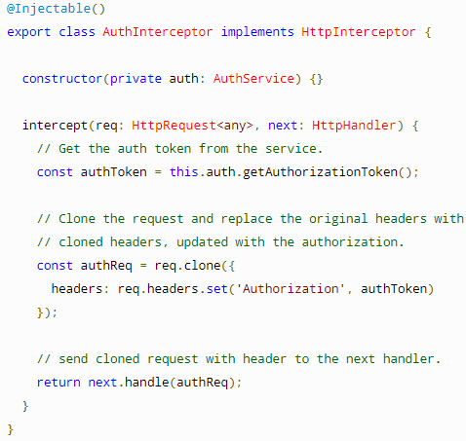
Http Client
Example
Adds an authorization header with that token to every outgoing request

Slide 27
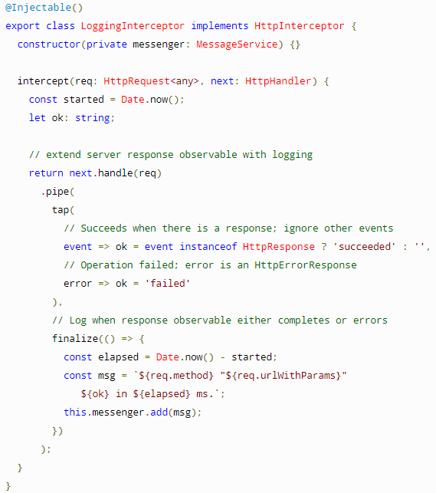
Http Client

Slide 28
Libs
https://ng-bootstrap.github.io/#/components/modal/examples
https://ng-bootstrap.github.io/#/components/alert/examples

Slide 29
Observables & RxJS

Slide 30
Observables & RxJS
https://rxjs-dev.firebaseapp.com/guide/observable
https://www.learnrxjs.io/
http://reactivex.io/documentation/observable.html
https://developer.mozilla.org/vi/docs/Web/JavaScript/Reference/Statements/async_function
https://techtalk.vn/chon-promise-hay-observable-khi-lam-viec-voi-angular.html

Slide 31
Observables & RxJS
Define a function for publishing values, but it is not executed until a consumer subscribes to it.
The subscribed consumer then receives notifications until the function completes, or until they unsubscribe.
An Observable is a lazily evaluated computation that can synchronously or asynchronously return zero to (potentially) infinite values from the time it's invoked onwards.
A Function is a lazily evaluated computation that synchronously returns a single value on invocation.

Slide 32
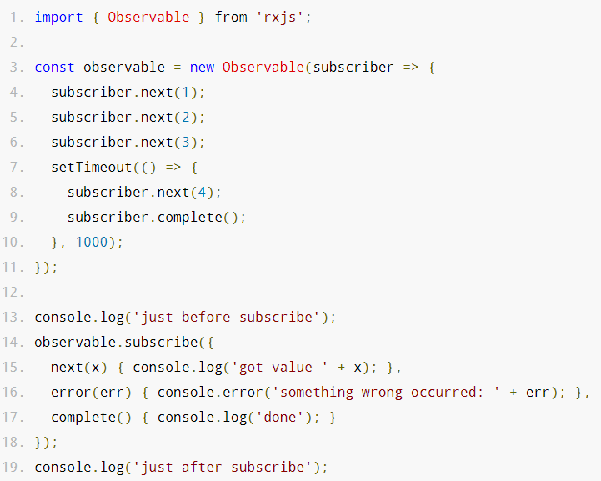
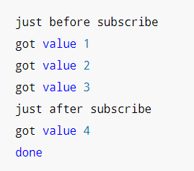

Slide 33
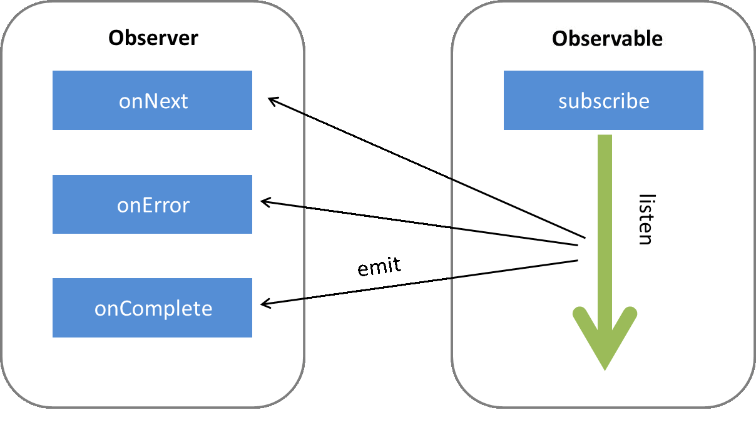
Observables & RxJS

Slide 34
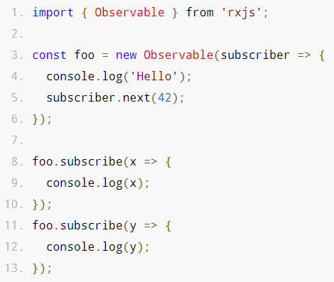
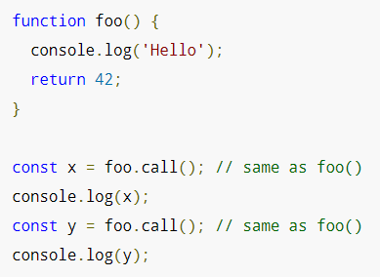

Slide 35
onNext
An Observable calls this method whenever the Observable emits an item. This method takes as a parameter the item emitted by the Observable.
onError
An Observable calls this method to indicate that it has failed to generate the expected data or has encountered some other error. It will not make further calls to onNext or onCompleted. The onError method takes as its parameter an indication of what caused the error.
onCompleted
An Observable calls this method after it has called onNext for the final time, if it has not encountered any errors.

Slide 36
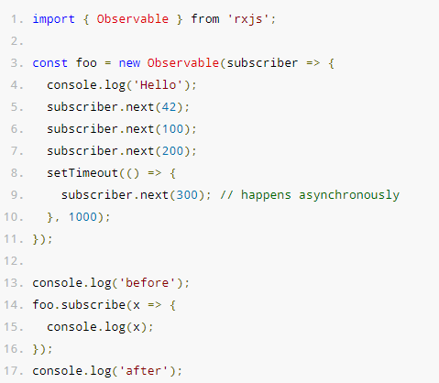
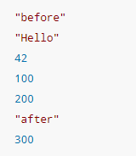
What is the difference between an Observable and a function?
Observables can "return" multiple values over time, something which functions cannot.

Slide 37
func.call() means "give me one value synchronously"
observable.subscribe() means "give me any amount of values, either synchronously or asynchronously"

Slide 38
Anatomy
Creating Observables
The Observable constructor takes one argument: the subscribe function.
Most commonly, observables are created using creation functions, like of, from, interval, etc.
Subscribing to Observables
Subscribing to an Observable is like calling a function, providing callbacks where the data will be delivered to.
Executing Observables
next*(error|complete)?
Disposing Observable Executions
subscription.unsubscribe();

Slide 39
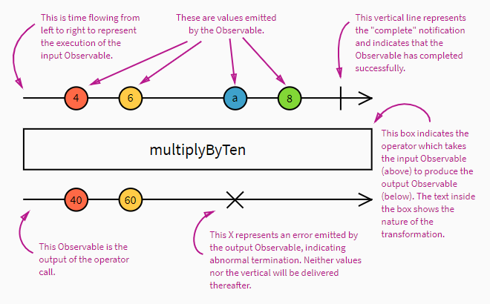

Slide 40
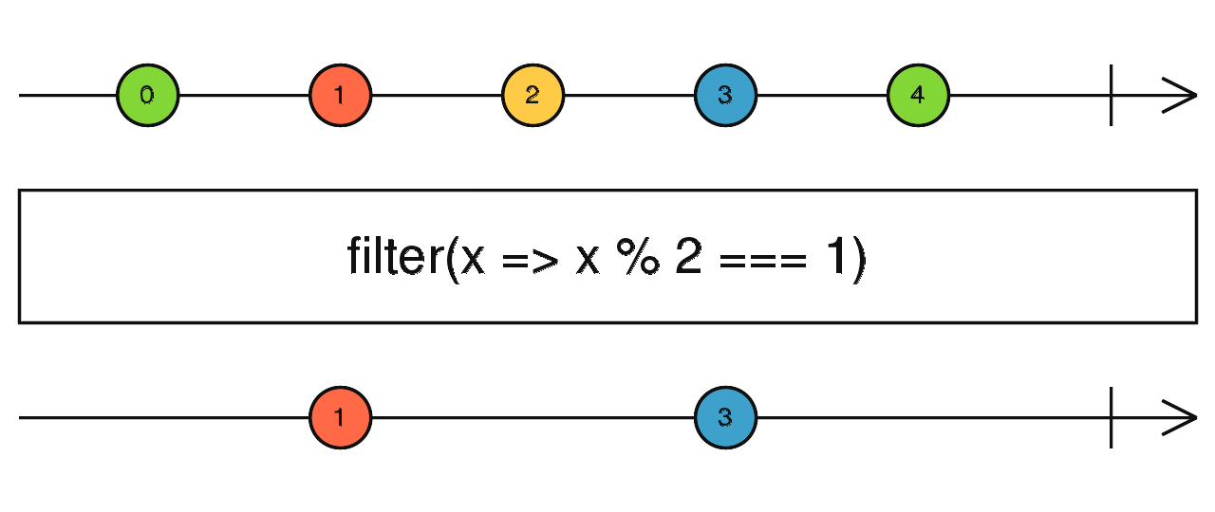
Example for filter

Slide 41
Subject
A special type of Observable that allows values to be multicasted to many Observers.
Every Subject is an Observable. Given a Subject, you can subscribe to it, providing an Observer, which will start receiving values normally.
Every Subject is an Observer. It is an object with the methods next(v), error(e), and complete().

Slide 42
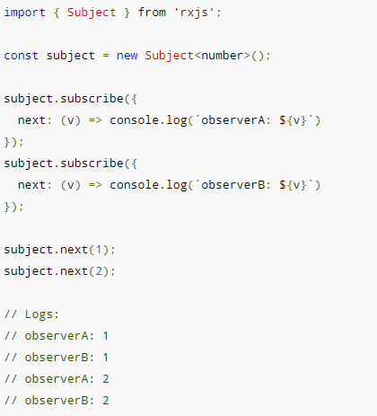

Slide 43
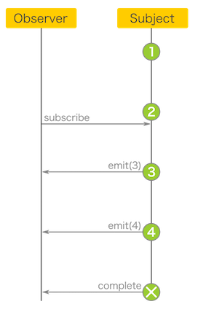
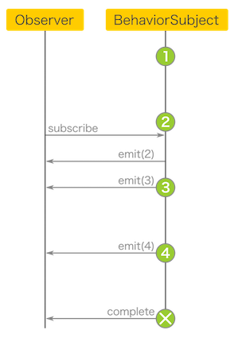
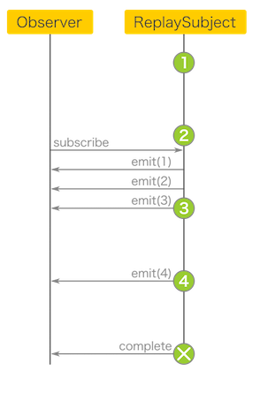
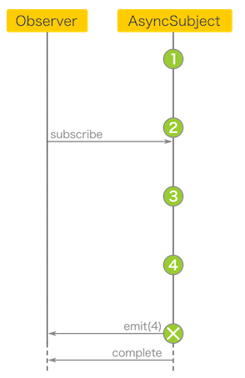

Slide 44
AuthGuard Demo
https://angular.dev/api/router/CanActivate

Slide 45
Routing & Navigation
Lazy loading
ng generate guard your-guard
Use route guards to prevent users from navigating to parts of an app without authorization. The following route guards
CanActivate
CanActivateChild
CanDeactivate
Resolve
CanLoad

